Slide 1
Supervised visual recognition: Understanding deep CNN
Interpretability Beyond Feature Attribution: Quantitative Testing with Concept Activation Vectors (TCAV), ICML 2018
The Building Blocks of Interpretability
Hyoungsung Kim

Slide 2
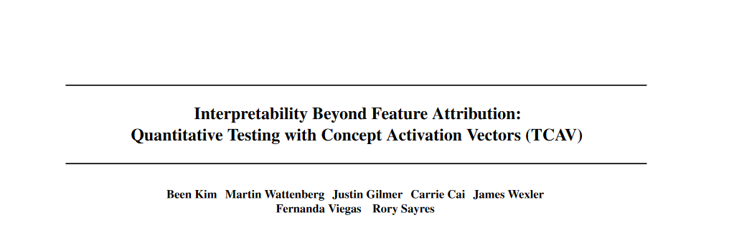
Published in ICML 2018

Slide 3
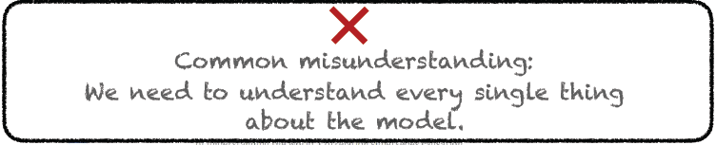
What is interpretability?
Writer said
“Interpretability is NOT about understanding all bits and bytes of the model. It is about knowing enough for your goals tasks”

Slide 4
Then… what the writer want to know?
Writer said, we need to ensure that
Our values are aligned
Our knowledge is reflected
Human
ML model

Slide 5
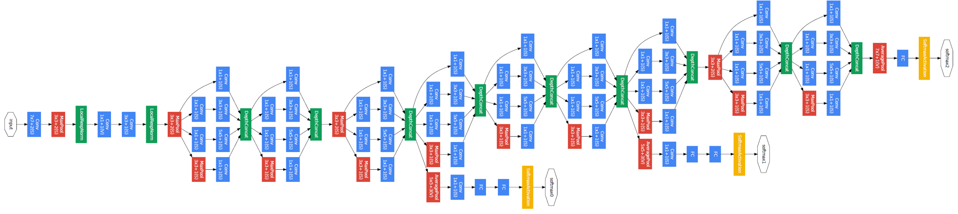
But…
The interpretation of deep learning models is a challenge due to their size, complexity, and often opaque internal size.
Network structure of GoogLeNet

Slide 6
To address this challenges…
Writers introduce Concept Activation Vectors(CAVs)
These provide an interpretation of a neural net’s internal state in terms of human-friendly concepts
And show how to use CAVs as part of a technique
Testing with CAVs(TCAV) that use directional derivatives to quantify the degree to which a user-defined concept is important to a classification result
For example, How sensitive a prediction of zebra is to the presence of stripes

Slide 7
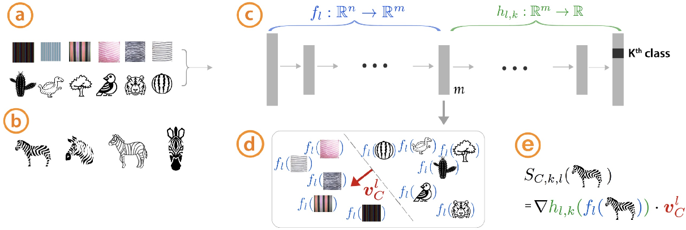
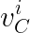
Example
Concept with random examples
: Layer l with n input neural, m output
: Layer l with m input neural and kth class (e.g. Fully connected layer)
C : Concept
Training images
: CAV of lth layer of concept C
: Test with CAV
Result in any layer
CAV is the vector orthogonal to the classification boundary.
CAVs are learned by training a linear classifier of (a)
Notes:
미분 : Sensitivity?
직교 벡터 : Direction with intensity?

Slide 8
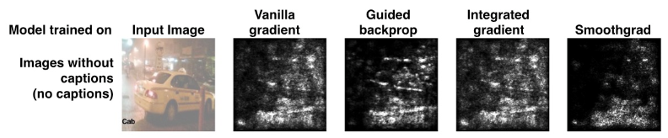
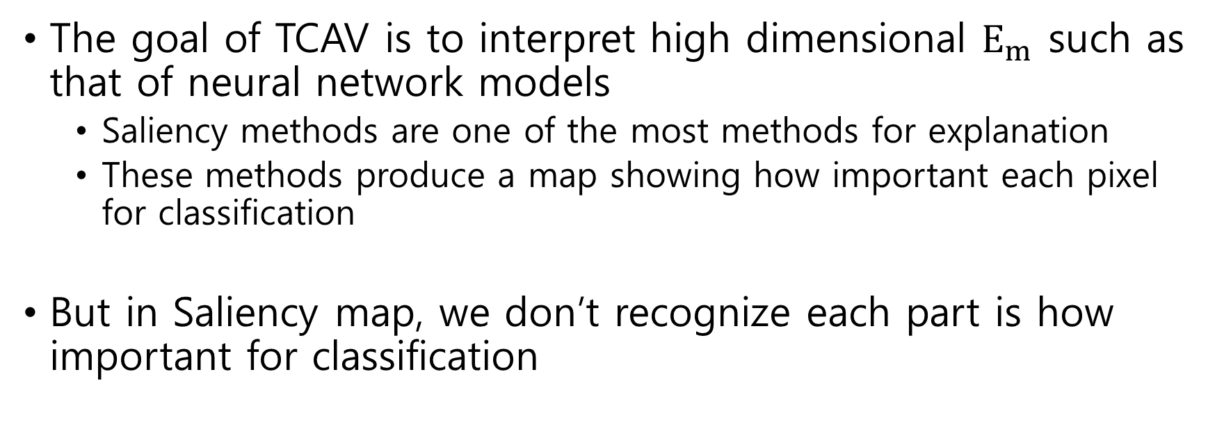
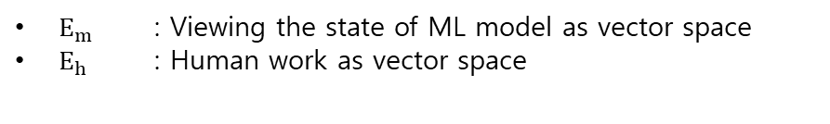
So…?
$E_{m}$ : Viewing the state of ML model as vector space
$E_{h}$ : Human work as vector space
The goal of TCAV is to interpret high dimensional $E_{m}$ such as that of neural network models
Saliency methods are one of the most methods for explanation
These methods produce a map showing how important each pixel for classification
But in Saliency map, we don’t recognize each part is how important for classification
Example of Saliency map

Slide 9
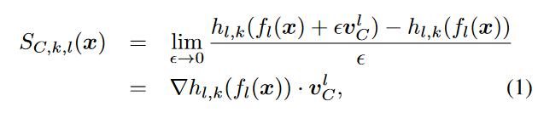
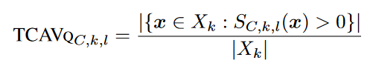
Methods
However, TCAV( function S(x) ) can quantitatively measure the sensitivity of model prediction with respect to concepts at any model layer.
x is a image
TCAV score
k : class label
$X_{k}$ : All input with given label k

Slide 10
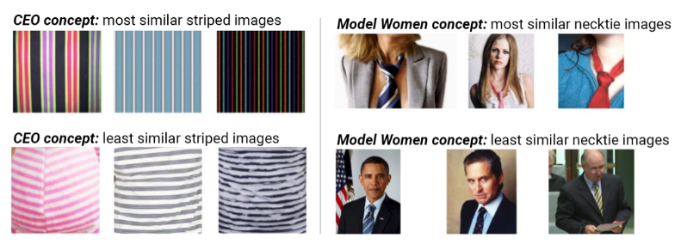
Validation
The learned CAVs are aligned with the intended concepts of interest?
Sort CAVs using cosine similarity
Cosine similarity : If cosine value of each vector is close to 1, then each vector is similar
Sorted imaged by concept
Left : Striped imaged with CEO concept
Writer said these may related to the ties or the suits that a CEO may wear
Right : Necktie images with model women concept

Slide 11
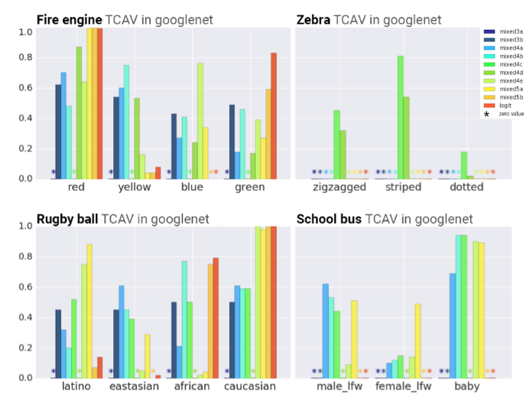
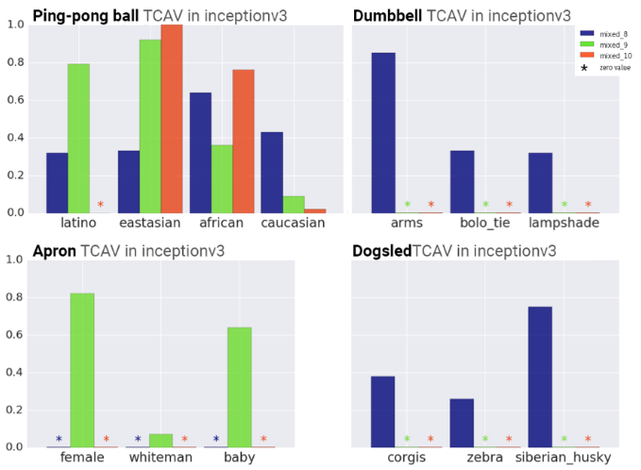
Insight and bias
Gaining Insight and discover bias Using TCAV
We can recognize which concept is important (e.g. Red color of fire engine, stripes of zebra)
We can recognize this network is sensitive to gender and race despite not being implicitly trained with these
Result of googleNet and Inception V3
Given image, get concept and TCAVs

Slide 12
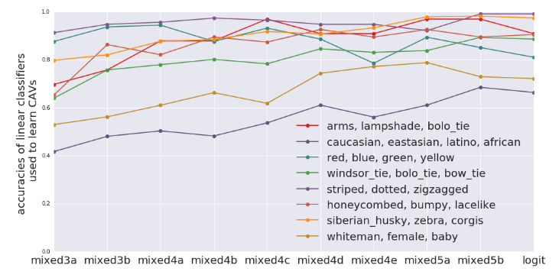
TCAV For Where Concepts Are Learned
Common sense
Lower layers operate as lower level feature detectors(e.g. edges)
Higher layers use these combination of lower-level features to infer higher-level features(e.g. object)
The accuracies of CAVs at each layer
Result shows that the accuracy of more abstract concepts(e.g., object) increase in higher layers of the network. And the accuracy of simpler concepts, such as color, is high throughout the entire network.

Slide 13
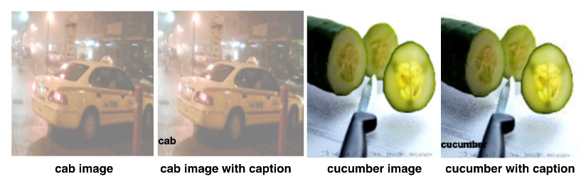
Saliency map vs TCAV
In this experiment, give picture with caption and observe each method works well
We can know each method is appropriate to interpret the function learned by a neural network
We will give a noise caption.
For example, if noise is 0, then all caption is correct. However if noise is 0.4, then 4 captions of 10 is wrong caption
Original image and image with caption

Slide 14
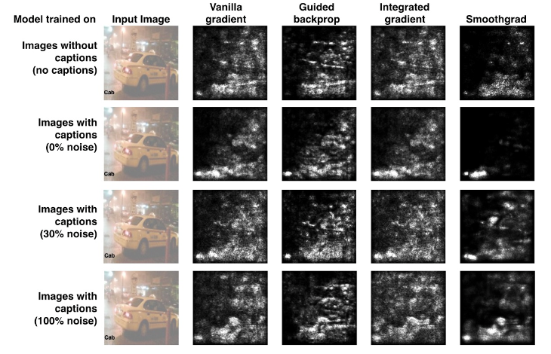
Saliency map
Saliency map methods are paying a lot of attention than image on caption
When the noise is 0, then Smoothgrad strongly focused on caption
Result of Saliency map methods

Slide 15
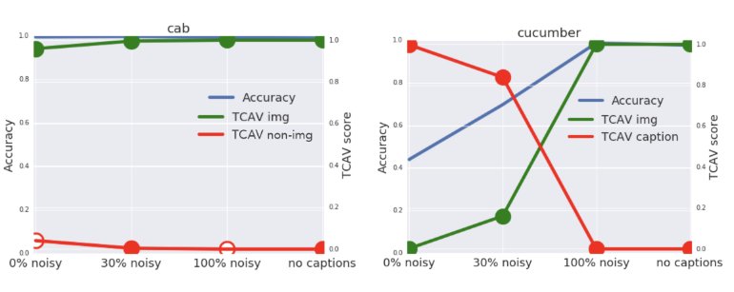
TCAV
Red line : TCAV score of caption
Green line : TCAV score of image
Blue line : Accuracy of classification
When image is clear(cab) image is used to classify the image
But in cucumber class, when noise is 0% caption is used. However when noise is increased, image is used to classify the image

Slide 16
Result
TCAV is a step toward creating a human-friendly linear interpretation of the internal state of a deep learning model
So that questions about model decisions may be answered in terms of natural high-level concepts

Slide 17
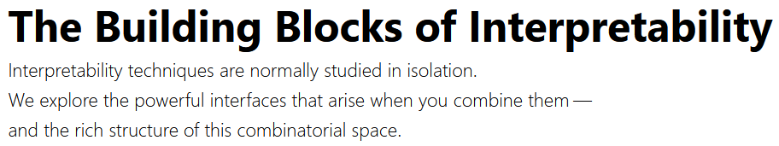
Published in Distill 2018

Slide 18
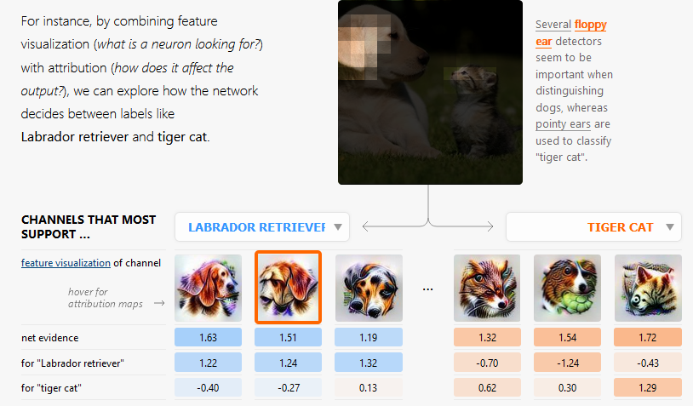
How do neural networks do what they do?
How do these neurons actually connect to what the network does in practice?
In this paper, writer explains how feature visualization can combine together with other interpretability techniques to understand aspects of how networks make decisions.
We will present interfaces that show what the network detects and explain how it develops its understanding, while keeping the amount of information human-scale.
For example, we will see how a network looking at a labrador retriever detects floppy ears and how that influences its classification.
Notes:
https://ai.googleblog.com/2018/03/the-building-blocks-of-interpretability.html

Slide 19
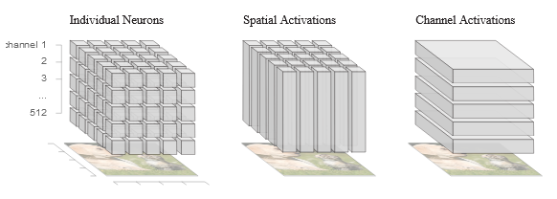
Making Sense of Hidden Layer
Image
CNN
Classification
Simple structure of CNN
Building blocks

Slide 20
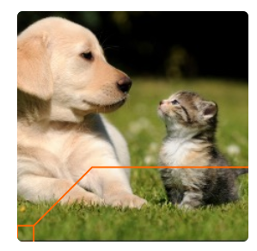
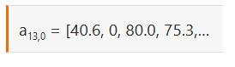
Making Sense of Hidden Layer
But making sense of these activations is hard because we usually work with them as abstract vector
The writers suggest “semantic dictionary” which are abstract vector transformation with feature visualization
Abstract vector of pixel(13, 0)

Slide 21
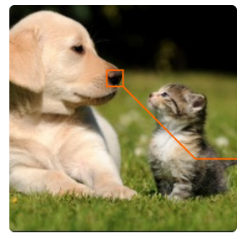
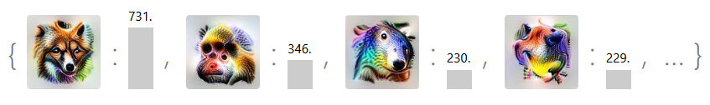
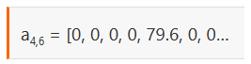
Semantic dictionary
To make a semantic dictionary, we pair every neuron activation with a visualization of that neuron and sort them by the magnitude of the activation.
This marriage of activations and feature visualization changes our relationship with the underlying mathematical object.
Activations now map to iconic representations, instead of abstract indices, with many appearing to be similar to salient human ideas, such as “floppy ear,” “dog snout,” or “fur.”
By bringing meaning to hidden layers, semantic dictionaries set the stage for our existing interpretability techniques to be composable building blocks.
Feature visualization

Slide 22
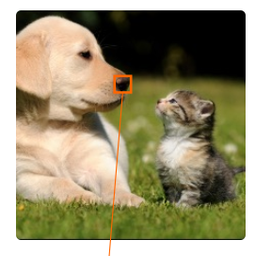
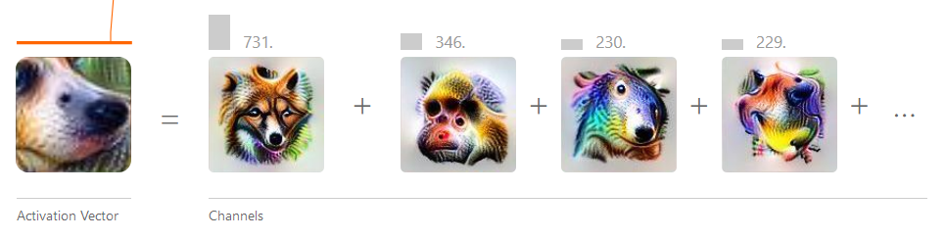
What Does the Network See?
Semantic dictionaries give us a fine-grained look at an activation: what does each single neuron detect?
Instead of visualizing individual neurons, we can instead visualize the combination of neurons that fire at a given spatial location.

Slide 23
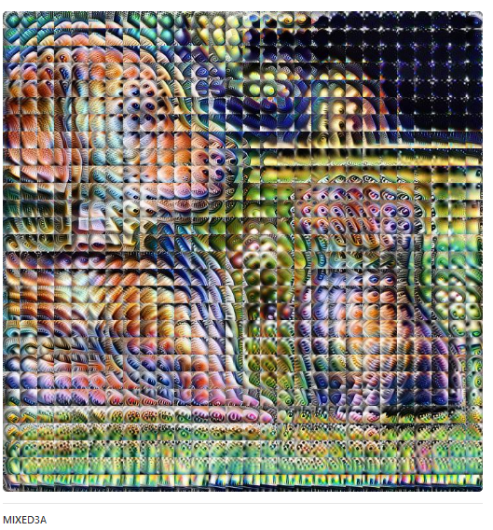
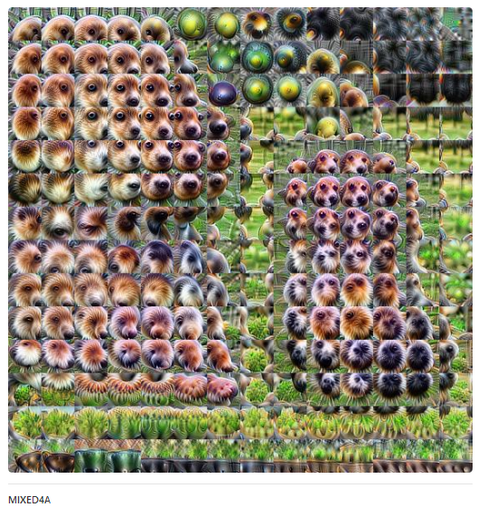
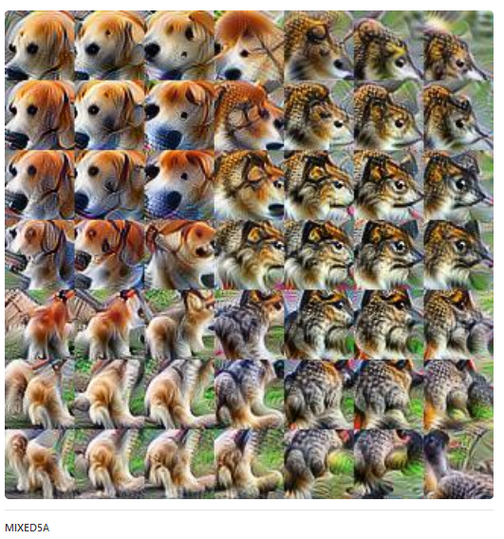
What Does the Network See?
Applying this technique to all the activation vectors allows us to not only see what the network detects at each position, but also what the network understands of the input image as a whole.
Result of some layer of GoogleNet.
we can observe how the network’s understanding evolves: from detecting edges in earlier layers, to more sophisticated shapes and object parts in the latter.

Slide 24
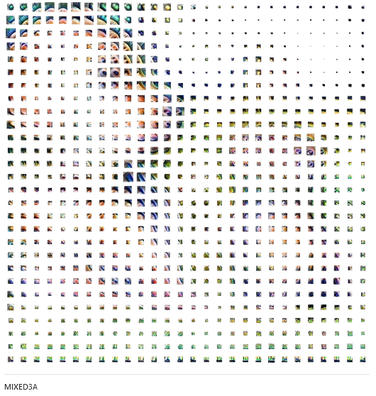
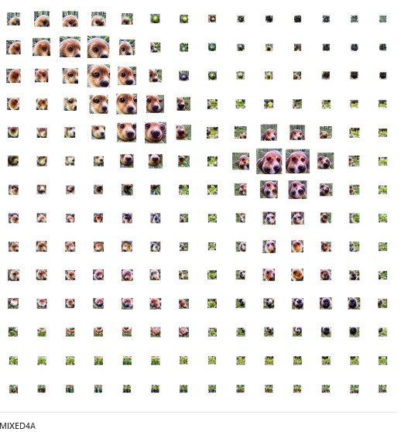
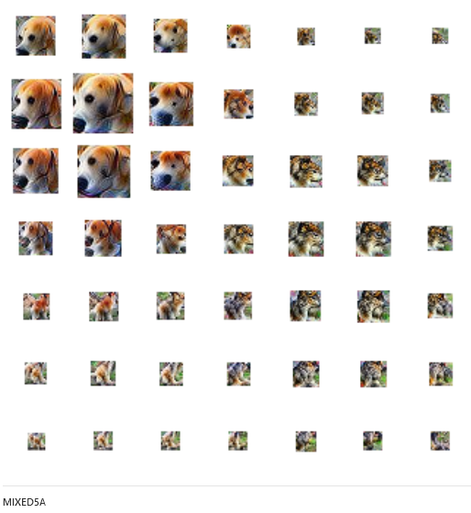
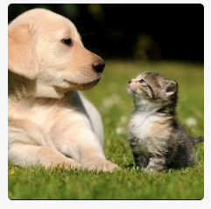
By scaling the area of each cell by the magnitude of the activation vector, we can indicate how strongly the network detected features at that position:
Original image

Slide 25
But…
We want to know “how much did each detector contribute to the final output?”
we cannot tell which specific detectors at each position most contributed to the final output classification.
Focusing on layer-to-layer attribution, it can still be valuable to focus on a single hidden layer. But there are drawbacks
It is very easy to end up with an overwhelming amount of information: it would take hours of human auditing to understand the long-tail of channels that slightly impact the output.
The aggregations we have explored are extremely lossy and can miss important parts of the story.
And, while we could avoid lossy aggregation by working with individual neurons, and not aggregating at all, this explodes the first problem combinatorially.

Slide 26
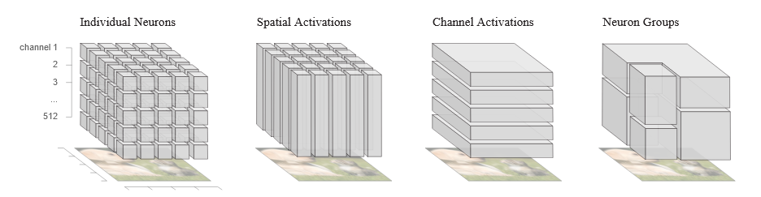
Making Things Human-Scale
We need better way: Matrix factorization
By flattening our cube into a matrix of spatial locations and channels, we can apply these techniques to get more meaningful groups of neurons.
They will be combinations of spatial locations and channels.
Moreover, these groups are constructed to explain the behavior of a network on a particular image.

Slide 27
Matrix factorization
Any grouping is inherently a tradeoff between reducing things to human scale and, because any aggregation is lossy, preserving information.
Matrix factorization lets us pick what our groupings are optimized for, giving us a better tradeoff than the natural groupings we saw earlier.
We can prioritize what we want to know
If we want to prioritize what the network detected, we would want the factorization to fully describe the activations.
If we instead wanted to prioritize what would change the network’s behavior, we would want the factorization to fully describe the gradient.
Finally, if we want to prioritize what caused the present behavior, we would want the factorization to fully describe the attributions.

Slide 28
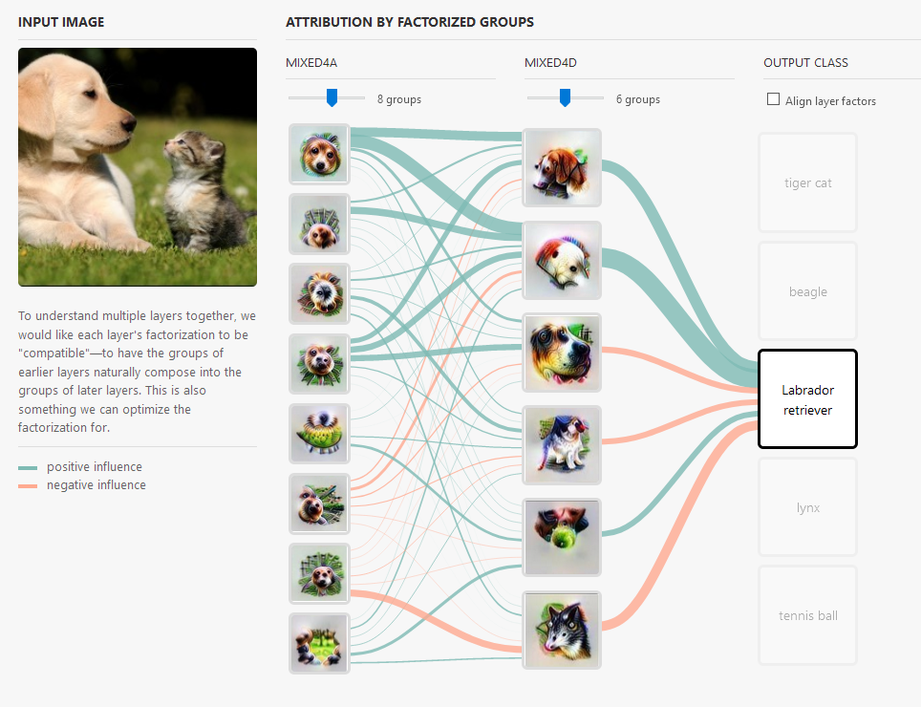
So…?
It can be useful to look across multiple layers to understand how a neural network assembles together lower-level detectors into higher-level concepts.
We can understand which parts of layers are used for classification

Slide 29
Result
Semantic dictionaries allow us to attribute to-and-from specific hidden layers.
We construct more optimal groupings of neurons.
These improved groupings are both more meaningful and more human-scale, making it less tedious for users to understand the behavior of the network.
This is not the complete set of building blocks; as new ones are discovered, they expand the space.
For example, Koh & Liang. Suggest ways of understanding the influence of dataset examples on model behavior
We can now imagine interfaces that not only allow us to inspect the influence of dataset examples on the final output classification (as Koh & Liang proposed), but also how examples influence the features of hidden layers, and how they influence the relationship between these features and the output.
For example, if we consider our “Labrador retriever” image, we can not only see which dataset examples most influenced the model to arrive at this classification, but also which dataset examples most caused the “floppy ear” detectors to fire, and which dataset examples most caused these detectors to increase the “Labrador retriever” classification.

